Slide 1
Results of the week
Daniil Terebilenko
Junior DevOps Engineer

Slide 2
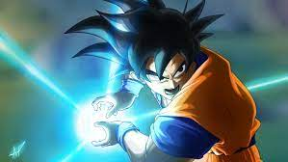
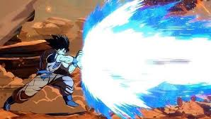


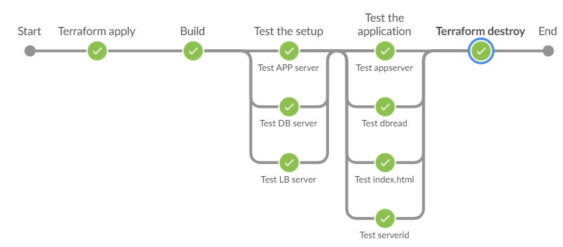

Combining already learned technologies

Slide 3

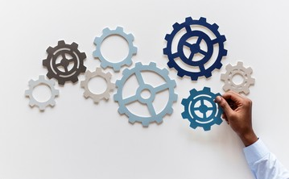
Kubernetes
Creating clusters:
Kind
Minikube
Configuring clusters:
kubectl

Slide 4
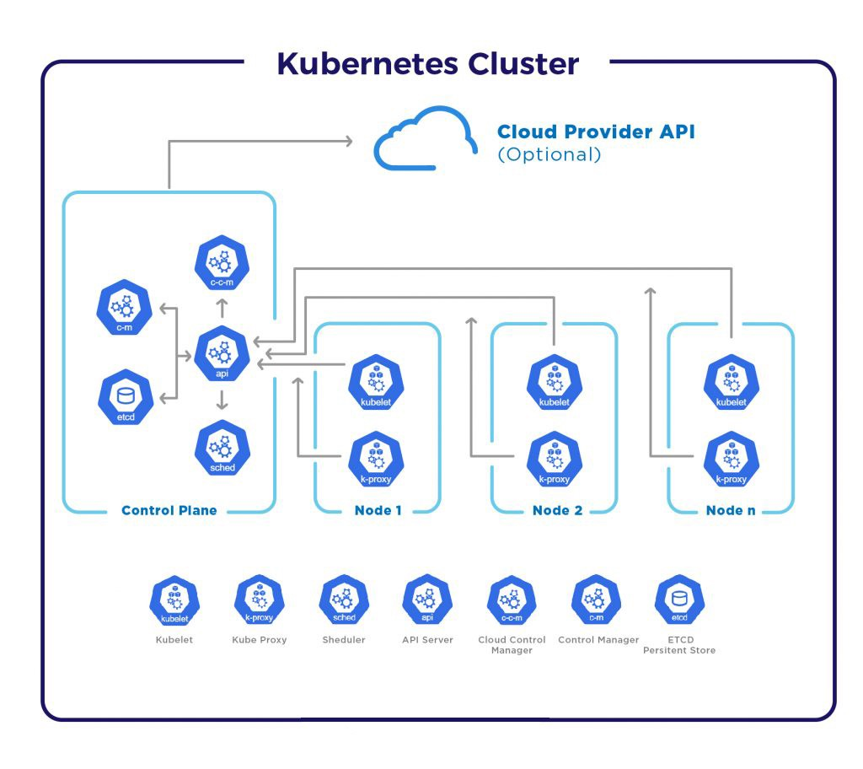
Kubernetes

Slide 5
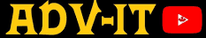
Kubernetes
Courses:
Kubernetes basics
ADV-IT

